Slide 1
Relational vs. Non-Relational Databases
Understanding Differences, Characteristics, Use Cases, and Advantages
By
Hafiz Salis

Slide 2
Introduction
Databases are the backbone of data storage and management.
Two primary types: Relational (SQL) and Non-Relational (NoSQL).
This presentation explores their key differences, use cases, and advantages.

Slide 3
What is a Relational Database?
Structured format based on tables, rows, and columns.
Uses Structured Query Language (SQL) for data manipulation.
Examples: MySQL, PostgreSQL, Oracle Database.

Slide 4
Characteristics of Relational Databases
- Fixed schema for data organization.
- Ensures data integrity and relationships using primary and foreign keys.
- Suitable for transactional systems.

Slide 5
What is a Non-Relational Database?
Designed for unstructured, semi-structured, or structured data.
Does not rely on tables, rows, and columns.
Examples: MongoDB, Cassandra, DynamoDB.

Slide 6
Characteristics of Non-Relational Databases
- Flexible schema for varying data formats.
- Highly scalable for large datasets.
- Suitable for big data and real-time applications.

Slide 7
Use Cases of Relational Databases
- Banking and financial applications.
- Enterprise Resource Planning (ERP) systems.
- Customer Relationship Management (CRM) systems.

Slide 8
Use Cases of Non-Relational Databases
- Social media platforms.
- IoT data storage.
- Content management systems (CMS) and e-commerce platforms.

Slide 9
Advantages of Relational Databases
- Strong consistency and data integrity.
- Well-suited for complex queries.
- Mature technology with extensive support.

Slide 10
Advantages of Non-Relational Databases
- High scalability and flexibility.
- Handles large volumes of diverse data types.
- Optimized for modern applications requiring high-speed access.

Slide 11
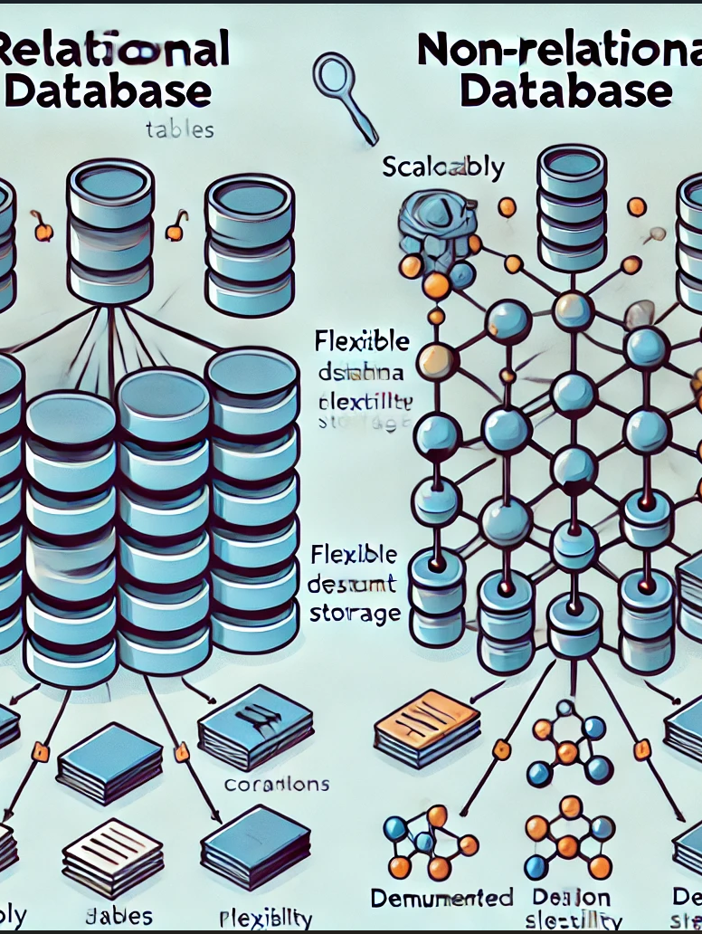
Key Differences
A comparative diagram:
1. Schema: Fixed vs. Flexible
2. Scalability: Vertical vs. Horizontal
3. Data Types: Structured vs. Various

Slide 12
Conclusion
Both types of databases have unique strengths.
Relational databases are ideal for structured data and consistency.
Non-relational databases excel in scalability and handling diverse data types.

Slide 13
References
1. MongoDB Documentation: https://www.mongodb.com
2. PostgreSQL Documentation: https://www.postgresql.org
3. Oracle Database Overview: https://www.oracle.com/database

